Slide 1
Introductory Statistics
Tenth Edition
Prem Mann
Chapter 3
Numerical Descriptive Measures
This slide deck contains animations. Please disable animations if they cause issues with your device.
Copyright ©2021 John Wiley & Sons, Inc.

Slide 2
Opening Example
Do you drink coffee? If you do, how many cups do you drink a day? Do you drink more or less than a typical American drinks per day? Do you know how much coffee Americans consume per year on average? Do you know in which country people consume the most coffee per year per person? Do you know the average price of coffee in America? For answers to all these questions, see Case Study 3.1.

Slide 3
3.1 Measures of Center for Ungrouped Data
Mean
Median
Mode
Relationships among the Mean, Median, and Mode

Slide 4
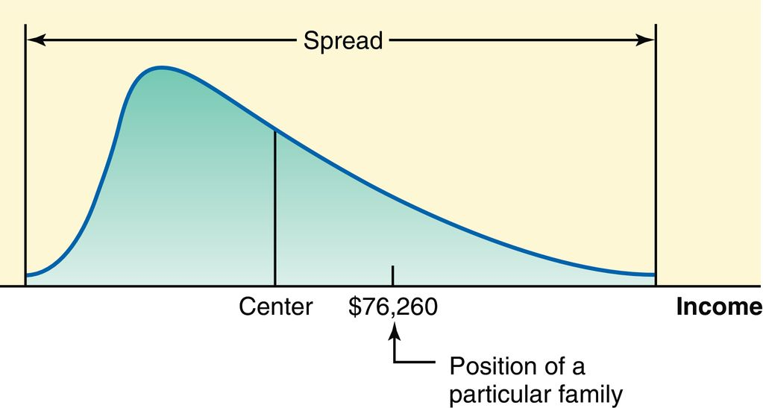
Figure 3.1

Slide 5
Mean
The mean for ungrouped data is obtained by dividing the sum of all values by the number of values in the data set. Thus,
Mean for population data:
Mean for sample data:
is the sum of all values; N is the population size; n is the sample size; µ is the population mean; and
where
is the sample mean.

Slide 6
Example 3-1
Table 3.1 lists the total revenues (rounded to billions of dollars) of 10 U.S. companies for the year 2018 (Fortune.com, August 2019).

Slide 7
Table 3.1 2018 Revenues of 10 U.S. Companies
Company | Revenue (billions of dollars)
Apple | 266
AT&T | 171
Walmart | 514
Exxon Mobil | 290
Ford Motor | 160
General Electric | 120
Citigroup | 97
Alphabet | 137
Amazon.com | 233
Microsoft | 110
Find the mean of 2018 profits for these 10 companies.

Slide 8
Example 3-1: Solution
Σ x = x₁ + x₂ + x₃ + x₄ + x₅ + x₆ + x₇ + x₈ + x₉ + x₁₀
Σx = 266 + 171 + 514 + 290 + 160 + 120 + 97 + 137 + 233 + 110 = 2098
Thus, the average revenue of these 10 companies was $209.8 billion in 2018.

Slide 9
Example 3-2
The following are the ages (in years) of all eight employees of a small company:
53 32 61 27 39 44 49 57
Find the mean age of these employees.

Slide 10
Example 3-2: Solution
The population mean is
Thus, the mean age of all eight employees of this company is 45.25 years, or 45 years and 3 months.

Slide 11
Example 3-3
Following are the list prices of eight homes randomly selected from all homes for sale in a city:
$245,670 | 176,200 | 360,280 | 272,440
450,394 | 310,160 | 393,610 | 3,874,480
Note that the price of the last house is $3,874,480, which is an outlier. Show how the inclusion of this outlier affects the value of the mean.

Slide 12
Example 3-3: Solution (1 of 2)
If we do not include the price of the most expensive house (the outlier), the mean of the prices of the other seven homes is:
Mean without the outlier

Slide 13
Example 3-3: Solution (2 of 2)
Now, to see the impact of the outlier on the value of the mean, we include the price of the most expensive home and find the mean price of eight homes. This mean is
Mean without the outlier
Thus, when we include the price of the most expensive home, the mean more than doubles, as it increases from $315,536.29 to $760,404.25.

Slide 14
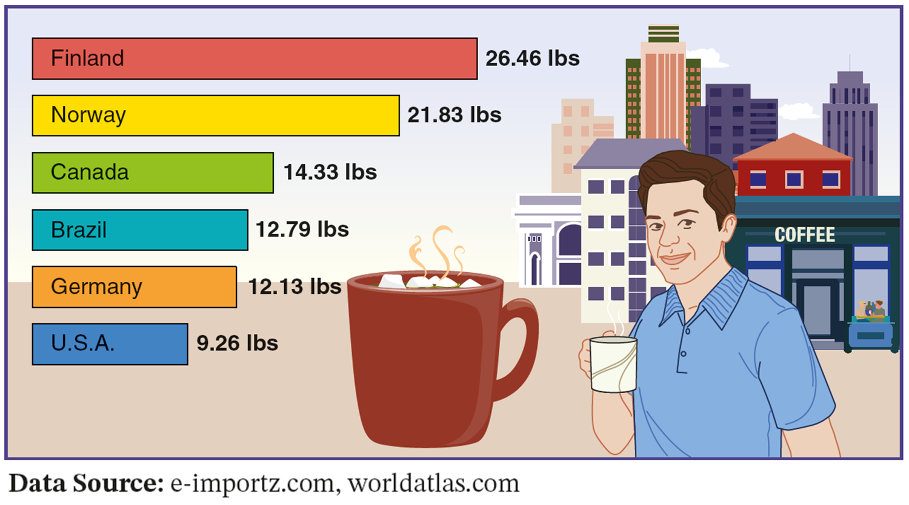
Case Study 3-1 Coffee Consumption Statistics
Data Source: e-importz.com, worldatlas.com

Slide 15
Median (1 of 2)
Definition
The median is the value that divides a data set that has been ranked in increasing order in two equal halves.
If the data set has an odd number of values, the median is given by the value of the middle term in the ranked data set.
If the data set has an even number of values, the median is given by the average of the two middle values in the ranked data set.

Slide 16
Calculating the Median
The calculation of the median consists of the following two steps:
Rank the given data set in increasing order.
Find the value that divides the ranked data set in two equal parts. This value gives the median.

Slide 17
Example 3-4
Table 3.2 lists the 2019 salaries (base salary plus bonuses that are not performance based) of 11 college football head coaches (source: boydsbets.com).
Find the median for these data.

Slide 18
Table 3.2 Compensations of 11 Female CEOs
Head Coach and College | 2019 salary (millions of dollars)
Dabo Swinney (Clemson) | 10.3
Ryan Day (Ohio State) | 4.5
Chip Kelly (UCLA) | 3.3
Manny Diaz (Miami, FL) | 3.1
Nick Saban (Alabama) | 8.7
David Shah (Stanford) | 4.3
Mack Brown (North Carolina) | 3.5
Lincoln Riley (Oklahoma) | 4.8
Tom Herman (Texas) | 5.5
James Franklin (Penn State) | 4.8
Les Miles (Kansas) | 2.8

Slide 19
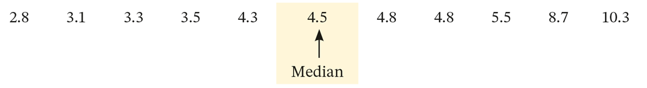
Example 3-4: Solution
To calculate the median of this data set, we perform the following two steps.
Step 1: We rank the given data in increasing order as follows:
2.8 3.1 3.3 3.5 4.3 4.5 4.8 4.8 5.5 8.7 10.3
Step 2: The second step is to find the value that divides this ranked data set in two equal parts. Here there are 11 data values. The sixth value divides these 11 values in two equal parts. Hence, the sixth value gives the median as shown below
Thus, the median of the 2019 salaries of these 11 college football head coaches is $4.5 million. (Note that by the time this book is published, some of these coaches may not be at these colleges.)

Slide 20
Example 3-5
The following data give the cell phone minutes used last month by 12 randomly selected persons.
230 | 2053 | 160 | 397 | 510 | 380
263 | 3864 | 184 | 201 | 326 | 721
Find the median for these data.

Slide 21
Example 3-5: Solution
To calculate the median, we perform the following two steps.
Step 1: We rank the given data in increasing order as follows:
160 184 201 230 263 326 380 397 510 721 2053 3864
Step 2: The value that divides 12 data values in two equal parts falls between the sixth and the seventh values. Thus, the median will be given by the average of the sixth and the seventh values as follows.

Slide 22
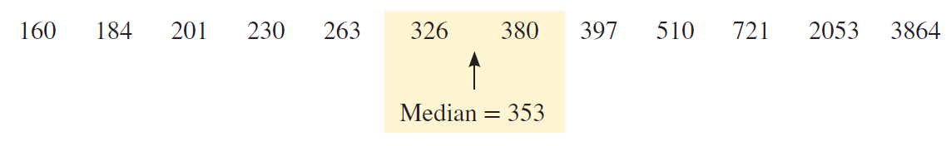
Example 3-5: Solution
Median = average of two middle values =
Thus, the median cell phone minutes used last month by these 12 persons was 353.

Slide 23
Median (2 of 2)
The median gives the center of a histogram, with half the data values to the left of the median and half to the right of the median. The advantage of using the median as a measure of central tendency is that it is not influenced by outliers. Consequently, the median is preferred over the mean as a measure of center for data sets that contain outliers.

Slide 24
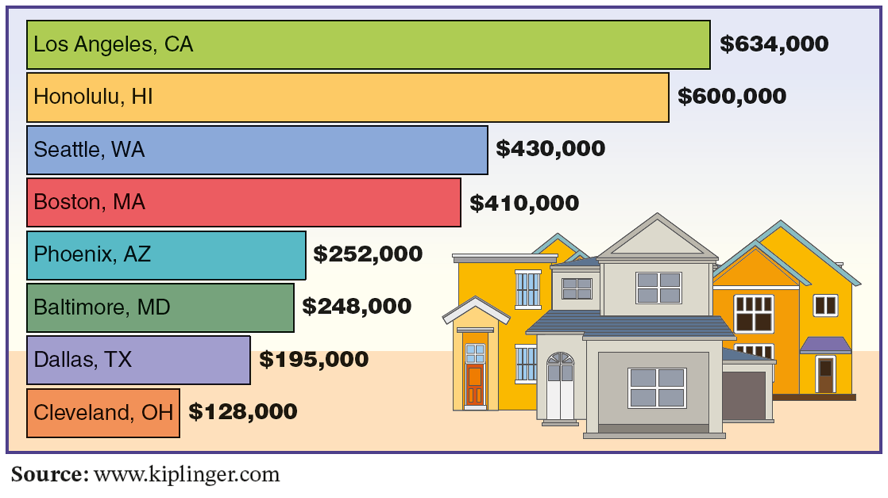
Case Study 3-2 Median Prices of Homes in Selected Metro Areas
Source: www.Kiplinger.com

Slide 25
Mode (1 of 3)
Definition
The mode is the value that occurs with the highest frequency in a data set.

Slide 26
Example 3-6
The following data give the speeds (in miles per hour) of eight cars that were stopped on I-95 for speeding violations.
77 | 82 | 74 | 81 | 79 | 84 | 74 | 78
Find the mode.

Slide 27
Example 3-6: Solution
In this data set, 74 occurs twice and each of the remaining values occurs only once. Because 74 occurs with the highest frequency, it is the mode. Therefore,
Mode = 74 miles per hour

Slide 28
Mode (2 of 3)
A major shortcoming of the mode is that a data set may have none or may have more than one mode, whereas it will have only one mean and only one median.
Unimodal: A data set with only one mode.
Bimodal: A data set with two modes.
Multimodal: A data set with more than two modes.

Slide 29
Example 3-7 (Data set with no mode)
Last year’s incomes of five randomly selected families were $76,150, $95,750, $124,985, $87,490, and $53,740.
Find the mode.

Slide 30
Example 3-7: Solution
Because each value in this data set occurs only once, this data set contains no mode.

Slide 31
Example 3-8 (Data set with two modes)
A small company has 12 employees. Their commuting times (rounded to the nearest minute) from home to work are 23, 36, 14, 23, 47, 32, 8, 14, 26, 31, 18, and 28, respectively.
Find the mode for these data.

Slide 32
Example 3-8: Solution
In the given data on the commuting times of these 12 employees, each of the values 14 and 23 occurs twice, and each of the remaining values occurs only once. Therefore, this data set has two modes: 14 and 23 minutes.

Slide 33
Example 3-9 (Data set with three modes)
The ages of 10 randomly selected students from a class are 21, 19, 27, 22, 29, 19, 25, 21, 22 and 30 years, respectively.
Find the mode.

Slide 34
Example 3-9: Solution
This data set has three modes: 19, 21 and 22. Each of these three values occurs with a (highest) frequency of 2.

Slide 35
Mode (3 of 3)
One advantage of the mode is that it can be calculated for both kinds of data–quantitative and qualitative–whereas the mean and median can be calculated for only quantitative data.

Slide 36
Example 3-10
The status of five students who are members of the student senate at a college are senior, sophomore, senior, junior, and senior, respectively. Find the mode.

Slide 37
Example 3-10: Solution
Because senior occurs more frequently than the other categories, it is the mode for this data set. We cannot calculate the mean and median for this data set.

Slide 38
Trimmed Mean
After we drop k% of the values from each end of a ranked
Data set, the mean of the remaining values is called the k% trimmed mean.
Thus, to calculate the trimmed mean for a data set, first we rank the given data in increasing order. Then we drop k% of The values from each end of the ranked data where k is any Positive number, such as 5%, 10%, and so on. The mean of the remaining values is called the k% trimmed mean.

Slide 39
Example 3-11
The following data give the money spent (in dollars) on books during 2015 by 10 students selected from a small college.
890 | 1354 | 1861 | 1644 | 87 | 5403 | 1429 | 1993 | 938 | 2176
Calculate the 10% trimmed mean.

Slide 40
Example 3-11: Solution (1 of 2)
To calculate the trimmed mean, first we rank the given data as below.
87 | 890 | 938 | 1354 | 1429 | 1644 | 1861 | 1993 | 2176 | 5403
To calculate the 10% trimmed mean, we drop 10% of the data values from each end of the ranked data.
10% of 10 values = 10 (.10) = 1
Hence, we drop one value from each end of the ranked data. After we drop the two values, one from each end, we are left with the following eight values:
890 | 938 | 1354 | 1429 | 1644 | 1861 | 1993 | 2176

Slide 41
Example 3-11: Solution (2 of 2)
Σ x = 890 + 938 + 1354 + 1429 +1644 + 1861 + 1993 + 2176 = 12,285
Thus, by dropping 10% of the values from each end of the ranked data for this example, we can state that students spent an average of $1535.63 on books in 2015.
Since in this data set $87 and $5403 can be considered outliers, it makes sense to drop these two values and calculate the trimmed mean for the remaining values rather than calculating the mean of all 10 values.

Slide 42
Weighted Mean (1 of 2)
When different values of a data set occur with different frequencies, that is, each value of a data set is assigned different weight, then we calculate the weighted mean to find the center of the given data set.
To calculate the weighted mean for a data set, we denote the variable by x and the weights by w. We add all the weights and denote this sum by ∑w. Then we multiply each value of x by the corresponding value of w. The sum of the resulting products gives ∑xw. Dividing ∑xw by ∑w gives the weighted mean.

Slide 43
Weighted Mean (2 of 2)
The weighted mean is calculated as
where x and w denote the variable and the weights,
respectively.

Slide 44
Example 3-12
Maura bought gas for her car four times during June 2019. She bought 10 gallons at a price of $2.60 a gallon, 13 gallons at a price of $2.80 a gallon, 8 gallons at a price of $2.70 a gallon, and 15 gallons at a price of $2.75 a gallon. What is the average price that Maura paid for gas during June 2019?

Slide 45
Example 3-12: Solution Table 3.3 Prices and Amounts of Gas Purchased
Table 3.3 Prices and Amounts of Gas Purchased
Price (in dollars) x | Gallons of Gas w | xw
2.60 | 10 | 26.00
2.80 | 13 | 36.40
2.70 | 8 | 21.60
2.75 | 15 | 41.25
 | Σw = 46 | Σxw = 125.25

Slide 46
Example 3-12: Solution
Here the variable is the price of gas per gallon, and we will denote it by x. The weights are the number of gallons bought each time, and we will denote these weights by w. We list the values of x and w in Table 3.3, and find ∑w. Then we multiply each value of x by the corresponding value of w and obtain ∑xw by adding the resulting values. Finally, we divide ∑xw by ∑w to find the weighted mean.
Thus, Maura paid an average of $2.72 a gallon for the gas she bought in June 2015.

Slide 47
Relationships Among the Mean, Median, and Mode (1 of 3)
For a symmetric histogram and frequency distribution with one peak (see Figure 3.2), the values of the mean, median, and mode are identical, and they lie at the center of the distribution.

Slide 48
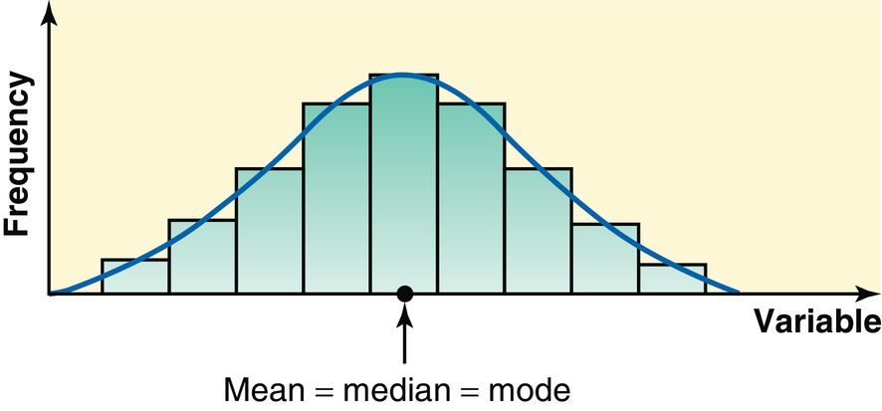
Figure 3.2 Mean, Median, and Mode for a Symmetric Histogram and Frequency Distribution Curve

Slide 49
Relationships Among the Mean, Median, and Mode (2 of 3)
For a histogram and a frequency distribution curve skewed to the right (see Figure 3.3), the value of the mean is the largest, that of the mode is the smallest, and the value of the median lies between these two. (Notice that the mode always occurs at the peak point.) The value of the mean is the largest in this case because it is sensitive to outliers that occur in the right tail. These outliers pull the mean to the right.

Slide 50
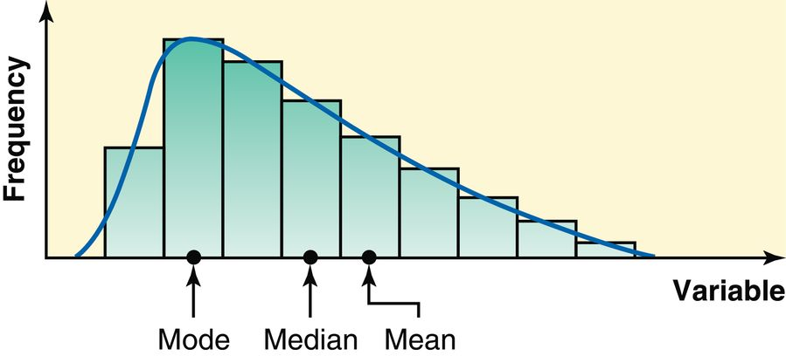
Figure 3.3 Mean, Median, and Mode for a Histogram and Frequency Distribution Curve Skewed to the Right

Slide 51
Relationships Among the Mean, Median, and Mode (3 of 3)
If a histogram and a frequency distribution curve are skewed to the left (see Figure 3.4), the value of the mean is the smallest and that of the mode is the largest, with the value of the median lying between these two. In this case, the outliers in the left tail pull the mean to the left.

Slide 52
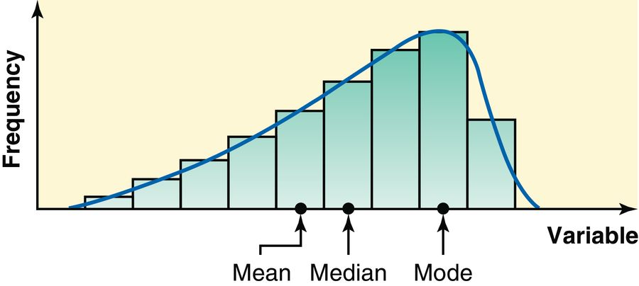
Figure 3.4 Mean, Median, and Mode for a Histogram and Frequency Distribution Curve Skewed to the Left

Slide 53
3.2 Measures of Dispersion for Ungrouped Data
Range
Variance and Standard Deviation
Population Parameters and Sample Statistics

Slide 54
Range (1 of 2)
Finding the Range for Ungrouped Data
Range = Largest value – Smallest Value

Slide 55
Example 3-13
Table 3.4 gives the total areas in square miles of the four western South-Central states of the United States.
Find the range for this data set.

Slide 56
Table 3.4
State | Total Area (square miles)
Arkansas | 53,182
Louisiana | 49,651
Oklahoma | 69,903
Texas | 267,277

Slide 57
Example 3-11: Solution
Range = Largest value – Smallest Value
= 267,277 – 49,651
= 217,626 square miles
Thus, the total areas of these four states are spread over a range of 217,626 square miles.

Slide 58
Range (2 of 2)
Disadvantages
The range, like the mean, has the disadvantage of being influenced by outliers. Consequently, the range is not a good measure of dispersion to use for a data set that contains outliers. This indicates that the range is a nonresistant measure of dispersion.
Its calculation is based on two values only: the largest and the smallest. All other values in a data set are ignored when calculating the range. Thus, the range is not a very satisfactory measure of dispersion.

Slide 59
Variance and Standard Deviation (1 of 5)
The standard deviation is the most-used measure of dispersion.
The value of the standard deviation tells how closely the values of a data set are clustered around the mean.
In general, a lower value of the standard deviation for a data set indicates that the values of that data set are spread over a relatively smaller range around the mean.

Slide 60
Variance and Standard Deviation (2 of 5)
In contrast, a larger value of the standard deviation for a data set indicates that the values of that data set are spread over a relatively larger range around the mean.
The standard deviation is obtained by taking the positive square root of the variance.

Slide 61
Variance and Standard Deviation (3 of 5)
The variance calculated for population data is denoted by σ² (read as sigma squared), and the variance calculated for sample data is denoted by s².
The standard deviation calculated for population data is denoted by σ, and the standard deviation calculated for sample data is denoted by s.

Slide 62
Variance and Standard Deviation (4 of 5)
Basic Formulas for the Variance and Standard Deviation for Ungrouped Data
where σ² is the population variance, s² is the sample variance, σ is the population standard deviation, and s is the sample standard deviation.

Slide 63
Table 3.5

Slide 64
Variance and Standard Deviation (5 of 5)
Short-cut Formulas for the Variance and Standard Deviation for Ungrouped Data
where σ² is the population variance, s² is the sample variance, σ is the population standard deviation, and s is the sample standard deviation.

Slide 65
Example 3-14 (1 of 2)
The following Table 3.2 (reproduced from Example 3.4) lists the 2019 salaries (base salary plus bonuses that are not performance based) of 11 college football head coaches (source: boydsbets.com).

Slide 66
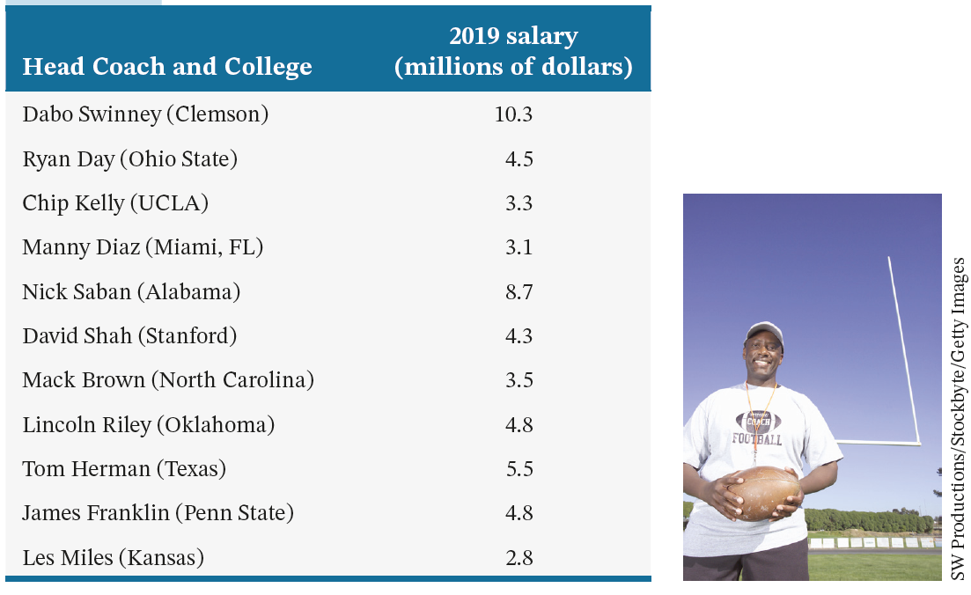
Example 3-14 (2 of 2)
Find the variance and standard deviation for these data.

Slide 67
Example 3-14: Solution (1 of 4)
Let x denote the 2019 salaries (in millions of dollars) of the 11 college football head coaches. The calculation of Σ x and Σ x 2 is shown in Table 3.6.

Slide 68
Example 3-14: Solution Table 3.6
x | x²
10.3 | 106.09
4.5 | 20.25
3.3 | 10.89
3.1 | 9.61
8.7 | 75.69
4.3 | 18.49
3.5 | 12.25
4.8 | 23.04
5.5 | 30.25
4.8 | 23.04
2.8 | 7.84
Σx = 55.6 | Σx² = 337.44

Slide 69
Example 3-14: Solution (2 of 4)
Step 1. Calculate Σx
The sum of values in the first column of Table 3.6 gives 55.6.
Step 2. Find Σx²
The value of Σ x 2 is obtained by squaring each value of x and then adding the squared values. The results of this step are shown in the second column of Table 3.6. Notice that Σ x 2 = 337.44.

Slide 70
Example 3-14: Solution (3 of 4)
Step 3. Determine the variance

Slide 71
Example 3-14: Solution (4 of 4)
Step 4. Obtain the standard deviation
Now to obtain the standard deviation, we take the (positive) square root of the variance.
s = √5.6407 = 2.3750 = $2.375 million
Thus, the standard deviation of the 2019 salaries of these 11 college football head coaches is $2.375 million.

Slide 72
Two Observations (1 of 2)
The values of the variance and the standard deviation are never negative. That is, the numerator in the formula for the variance should never produce a negative value. Usually the values of the variance and standard deviation are positive, but if a data set has no variation, then the variance and standard deviation are both zero.

Slide 73
Two Observations (2 of 2)
The measurement units of variance are always the square of the measurement units of the original data. This is so because the original values are squared to calculate the variance. The measurement units of the standard deviation are the same as the measurement units of the original data because the standard deviation is obtained by taking the square root of the variance.

Slide 74
Example 3-15
Following are the 2019 earnings (in thousands of dollars) before taxes for all six employees of a small company.
88.50 | 108.40 | 65.50 | 52.50 | 79.80 | 54.60
Calculate the variance and standard deviation for these data.

Slide 75
Example 3-15: Solution (1 of 2)
Let x denote the 2019 earnings before taxes of an employee of this company. The values of ∑x and ∑x² are calculated in Table 3.7.
x | x ²
88.50 | 7832.25
108.40 | 11,750.56
65.50 | 4290.25
52.50 | 2756.25
79.80 | 6368.04
54.60 | 2981.16
Σx = 449.30 | Σx² = 35,978.51

Slide 76
Example 3-15: Solution (2 of 2)
Thus, the standard deviation of the 2015 earnings of all six employees of this company is $19,721.

Slide 77
Warning
Note that ∑x² is not the same as (∑x)². The value of ∑x² is obtained by squaring the x values and then adding them. The value of (∑x)² is obtained by squaring the value of ∑x.

Slide 78
Coefficient of Variation
One disadvantage of the standard deviation as a measure of dispersion is that it is a measure of absolute variability and not of relative variability.
Sometimes we may need to compare the variability for two different data sets that have different units of measurement. In such cases, a measure of relative variability is preferable. One such measure is the coefficient of variation.

Slide 79
Coefficient of Variation (CV)
CV expresses the standard deviation as a percentage of the mean and is computed as follows:
Note that the coefficient of variation does not have any units of measurement, as it is always expressed as a percent.

Slide 80
Example 3-16
The yearly salaries of all employees working for a large company have a mean of $72,350 and a standard deviation of $12,820. The years of schooling (education) for the same employees have a mean of 15 years and a standard deviation of 2 years. Is the relative variation in the salaries higher or lower than that in years of schooling for these employees?
Answer the question by calculating the coefficient of variation for each variable.

Slide 81
Example 3-16: Solution (1 of 2)
Because the two variables (salary and years of schooling) have different units of measurement (dollars and years, respectively), we cannot directly compare the two standard deviations. Hence, we calculate the coefficient of variation for each of these data sets.

Slide 82
Example 3-16: Solution (2 of 2)
Thus, the standard deviation for salaries is 17.72% of its mean and that for years of schooling is 13.33% of its mean. Since the coefficient of variation for salaries has a higher value than the coefficient of variation for years of schooling, the salaries have a higher relative variation than the years of schooling.
Note that the coefficient of variation for salaries in the above example is 17.72%. This means that if we assume that the mean of salaries for these employees is 100, then the standard deviation of salaries is 17.72. Similarly, if the mean of years of schooling for these employees is 100, then the standard deviation of years of schooling is 13.33.

Slide 83
Population Parameter Versus Sample Statistic
A numerical measure such as the mean, median, mode, range, variance, or standard deviation calculated for a population data set is called a population parameter, or simply a parameter.
A summary measure calculated for a sample data set is called a sample statistic, or simply a statistic.

Slide 84
3.3 Mean, Variance, and Standard Deviation for Grouped Data
Mean for Grouped Data
Variance and Standard Deviation for Grouped Data

Slide 85
Mean for Grouped Data
Calculating Mean for Grouped Data
Mean for population data:
Mean for sample data:
where m is the midpoint and f is the frequency of a class.

Slide 86
Example 3-17 (1 of 2)
Table 3.8 gives the frequency distribution of the daily commuting times (in minutes) from home to work for all 25 employees of a company.
Calculate the mean of the daily commuting times.

Slide 87
Example 3-17 (2 of 2)
Daily Commuting Time (minutes) | Number of Employees
0 to less than 10 | 4
10 to less than 20 | 9
20 to less than 30 | 6
30 to less than 40 | 4
40 to less than 50 | 2

Slide 88
Example 3-17: Solution (1 of 2)
Daily Commuting Time (minutes) | f | m | m f
0 to less than 10 | 4 | 5 | 20
10 to less than 20 | 9 | 15 | 135
20 to less than 30 | 6 | 25 | 150
30 to less than 40 | 4 | 35 | 140
40 to less than 50 | 2 | 45 | 90
 | N = 25 |  | Σmf = 535

Slide 89
Example 3-17: Solution (2 of 2)
Thus, the employees of this company spend an average of 21.40 minutes a day commuting from home to work.

Slide 90
Example 3-18 (1 of 2)
Table 3.10 gives the frequency distribution of the number of orders received each day during the past 50 days at the office of a mail-order company.
Calculate the mean.

Slide 91
Example 3-18 (2 of 2)
Number of Orders | Number of Days
10–12 | 4
13–15 | 12
16–18 | 20
19–21 | 14

Slide 92
Example 3-18: Solution (1 of 2)
Number of Orders | f | m | m f
10–12 | 4 | 11 | 44
13–15 | 12 | 14 | 168
16–18 | 20 | 17 | 340
19–21 | 14 | 20 | 280
 | n = 50 |  | Σmf = 832

Slide 93
Example 3-18: Solution (2 of 2)
Thus, this mail-order company received an average of 16.64 orders per day during these 50 days.

Slide 94
Variance and Standard Deviation for Grouped Data (1 of 3)
Basic Formulas for the Variance and Standard Deviation for Grouped Data
where σ² is the population variance, s² is the sample variance, and m is the midpoint of a class. In either case, the standard deviation is obtained by taking the positive square root of the variance.

Slide 95
Variance and Standard Deviation for Grouped Data (2 of 3)
Short-Cut Formulas for the Variance and Standard Deviation for Grouped Data
where σ² is the population variance, s² is the sample variance, and m is the midpoint of a class.

Slide 96
Variance and Standard Deviation for Grouped Data (3 of 3)
Short-cut Formulas for the Variance and Standard Deviation for Grouped Data
The standard deviation is obtained by taking the positive square root of the variance.
Population standard deviation:
Sample standard deviation:

Slide 97
Example 3-19 (1 of 2)
The following data, reproduced from Table 3.8 of Example 3-17, give the frequency distribution of the daily commuting times (in minutes) from home to work for all 25 employees of a company.
Calculate the variance and standard deviation.

Slide 98
Example 3-19 (2 of 2)
Daily Commuting Time (minutes) | Number of Employees (f)
0 to less than 10 | 4
10 to less than 20 | 9
20 to less than 30 | 6
30 to less than 40 | 4
40 to less than 50 | 2

Slide 99
Example 3-19: Solution (1 of 2)
Table 3.12
Daily Commuting Time (minutes) | f | m | m f | m² f
0 to less than 10 | 4 | 5 | 20 | 100
10 to less than 20 | 9 | 15 | 135 | 2025
20 to less than 30 | 6 | 25 | 150 | 3750
30 to less than 40 | 4 | 35 | 140 | 4900
40 to less than 50 | 2 | 45 | 90 | 4050
 | N = 25 |  | Σmf = 535 | Σm²f = 535

Slide 100
Example 3-19: Solution (2 of 2)
Thus, the standard deviation of the daily commuting times for these employees is 11.62 minutes.

Slide 101
Example 3-20 (1 of 2)
The following data, reproduced from Table 3.10 of Example 3-18, give the frequency distribution of the number of orders received each day during the past 50 days at the office of a mail-order company.
Calculate the variance and standard deviation.

Slide 102
Example 3-20 (2 of 2)
Number of Orders | f
10–12 | 4
13–15 | 12
16–18 | 20
19–21 | 14

Slide 103
Example 3-20: Solution (1 of 2)
Table 3.13
Number of Orders | f | m | m f | m² f
10–12 | 4 | 11 | 44 | 484
13–15 | 12 | 14 | 168 | 2352
16–18 | 20 | 17 | 340 | 5780
19–21 | 14 | 20 | 280 | 5600
 | n = 50 |  | Σ mf = 832 | Σ m²f = 14,216

Slide 104
Example 3-20: Solution (2 of 2)
Thus, the standard deviation of the number of orders received at the office of this mail-order company during the past 50 days is 2.75.

Slide 105
3.4 Use of Standard Deviation
Chebyshev’s Theorem
Empirical Rule

Slide 106
Chebyshev’s Theorem
Definition
For any number k greater than 1, at least (1 – 1/k²) of the data values lie within k standard deviations of the mean.

Slide 107
Table 3.14 Areas Under the Distribution Curve Using Chebyshev’s Theorem
Table 3.14 Areas Under the Distribution Curve Using Chebysev’s Theorem

Slide 108
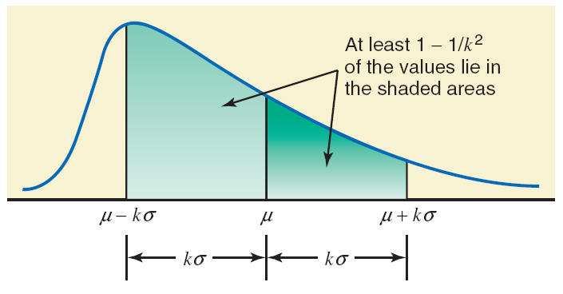
Figure 3.5 Chebyshev’s Theorem

Slide 109
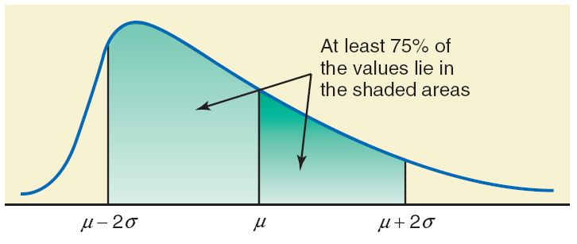
Figure 3.6 Percentage of Values within Two Standard Deviations of the Mean for Chebyshev’s Theorem

Slide 110
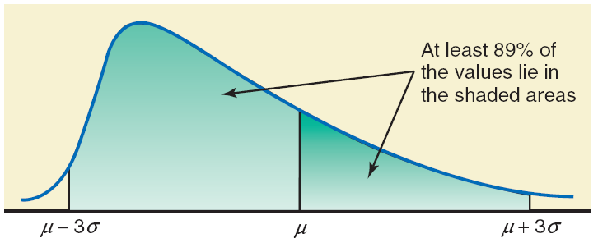
Figure 3.7 Percentage of Values within Three Standard Deviations of the Mean for Chebyshev’s Theorem

Slide 111
Example 3-21
The average systolic blood pressure for 4000 women who were screened for high blood pressure was found to be 187 mm Hg with a standard deviation of 22. Using Chebyshev’s theorem, find at least what percentage of women in this group have a systolic blood pressure between 143 and 231 mm Hg.

Slide 112
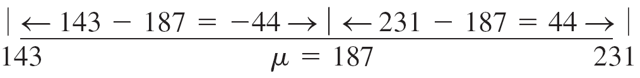
Example 3-21: Solution (1 of 2)
Let μ and σ be the mean and the standard deviation, respectively, of the systolic blood pressures of these women.
μ = 187 and σ = 22

Slide 113
Example 3-21: Solution (2 of 2)
The value of k is obtained by dividing the distance between the mean and each point by the standard deviation. Thus
k = 44/22 = 2
Hence, according to Chebyshev's theorem, at least 75% of the women have systolic blood pressure between 143 and 231 mm Hg. This percentage is shown in Figure 3.8.

Slide 114
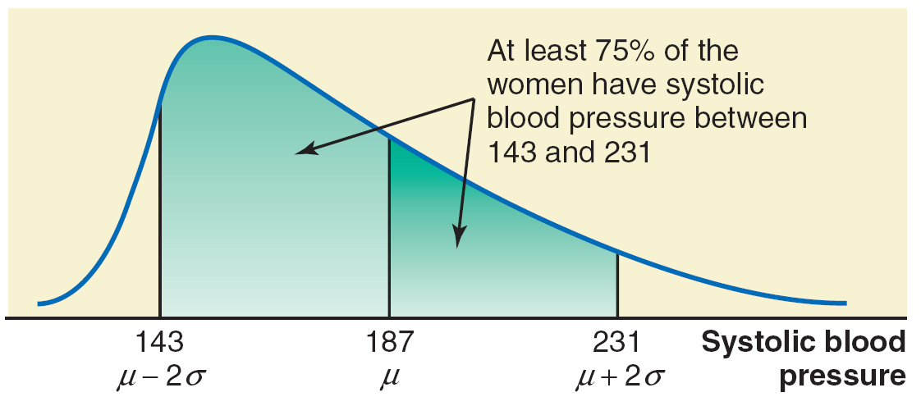
Figure 3.8 Percentage of Women with Systolic Blood Pressure between 143 and 231.

Slide 115
Empirical Rule
For a bell shaped distribution, approximately
68% of the observations lie within one standard deviation of the mean
95% of the observations lie within two standard deviations of the mean
99.7% of the observations lie within three standard deviations of the mean

Slide 116
Table 3.15 Approximate Areas Under a Bell-Shaped Distribution Using the Empirical Rule
Table 3.15 Approximate Areas under a Bell-Shaped Distribution Using the Empirical Rule
Interval | Approximate Area
µ ± 1 σ | 68%
µ ± 2 σ | 95%
µ ± 3 σ | 99.7%

Slide 117
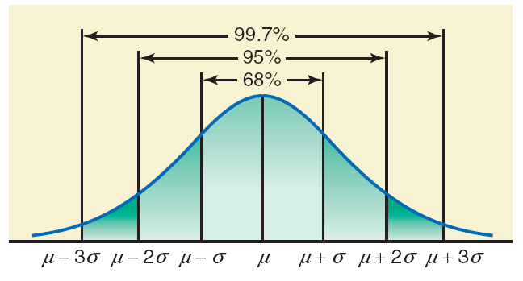
Figure 3.9 Illustration of the Empirical Rule.

Slide 118
Example 3-22
The age distribution of a sample of 5000 persons is bell-shaped with a mean of 40 years and a standard deviation of 12 years. Determine the approximate percentage of people who are 16 to 64 years old.

Slide 119
Example 3-22: Solution
From the given information, for this distribution,
and 𝒔 = 𝟏𝟐𝒚𝒆𝒂𝒓𝒔
Each of the two points, 16 and 64, is 24 units away from the mean.
Because the area within two standard deviations of the mean is approximately 95% for a bell-shaped curve, approximately 95% of the people in the sample are 16 to 64 years old.

Slide 120
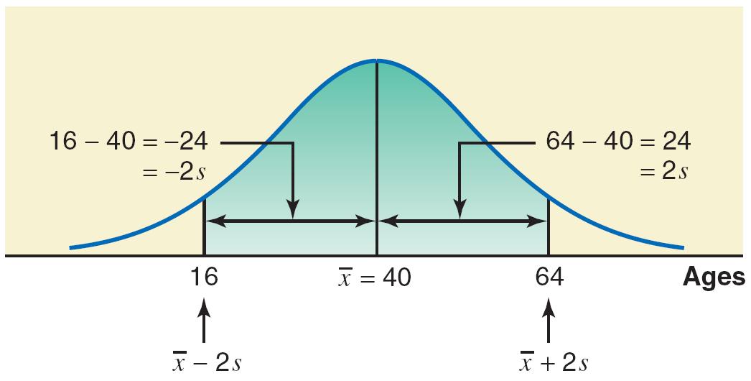
Figure 3.10 Percentage of People who are 16 to 64 Years Old

Slide 121
3.5 Measures of Position
Quartiles and Interquartile Range
Percentiles and Percentile Rank

Slide 122
Quartiles and Interquartile Range (1 of 2)
Definition
Quartiles are three summary measures that divide a ranked data set into four equal parts. The second quartile is the same as the median of a data set. The first quartile is the value of the middle term among the observations that are less than the median, and the third quartile is the value of the middle term among the observations that are greater than the median.

Slide 123
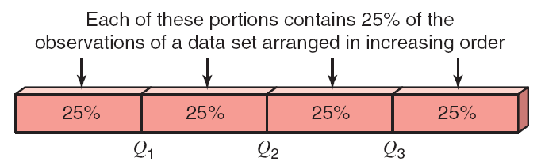
Figure 3.11 Quartiles

Slide 124
Quartiles and Interquartile Range (2 of 2)
Calculating Interquartile Range
The difference between the third and the first quartiles gives the interquartile range; that is,
IQR = Interquartile range = Q₃ – Q₁

Slide 125
Example 3-23
A sample of 12 commuter students was selected from a college. The following data give the typical one-way commuting times (in minutes) from home to college for these 12 students.
29 | 14 | 39 | 17 | 7 | 47 | 63 | 37 | 42 | 18 | 24 | 55
Find the values of the three quartiles.
Where does the commuting time of 47 fall in relation to the three quartiles?
Find the interquartile range.

Slide 126
Example 3-23: Solution (1 of 7)
We perform the following steps to find the three quartiles.
Step 1. First we rank the given data in increasing order as follows:
7 | 14 | 17 | 18 | 24 | 29 | 37 | 39 | 42 | 47 | 55 | 63

Slide 127
Example 3-23: Solution (2 of 7)
Step 2. We find the second quartile, which is also the median. In a total of 12 data values, the median is between sixth and seventh terms. Thus, the median and, hence, the second quartile is given by the average of the sixth and seventh values in the ranked data set, that is the average of 29 and 37. Thus, the second quartile is:
Note that Q_{𝟐} = 𝟑𝟑 is also the value of the median.

Slide 128
Example 3-23: Solution (3 of 7)
Step 3. We find the median of the data values that are smaller than Q₂, and this gives the value of the first quartile. The values that are smaller than Q₂ are:
7 | 14 | 17 | 18 | 24 | 29
The value that divides these six data values in two equal parts is given by the average of the two middle values,17 and 18. Thus, the first quartile is:

Slide 129
Example 3-23: Solution (4 of 7)
Step 4. We find the median of the data values that are larger than Q₂, and this gives the value of the third quartile. The values that are larger than Q₂ are:
37 | 39 | 42 | 47 | 55 | 63
The value that divides these six data values in two equal parts is given by the average of the two middle values, 42 and 47. Thus, the third quartile is:

Slide 130
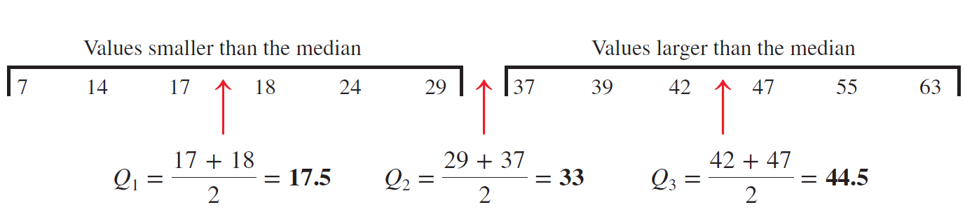
Example 3-23: Solution (5 of 7)
Now we can summarize the calculation of the three quartiles in the following figure:

Slide 131
Example 3-23: Solution (6 of 7)
The value of Q₁ = 17.5 minutes indicates that 25% of these 12 students in this sample commute for less than 17.5 minutes and 75% of them commute for more than 17.5 minutes. Similarly, Q₂ = 33 indicates that half of these 12 students commute for less than 33 minutes and the other half of them commute for more than 33 minutes. The value of Q₃ = 44.5 minutes indicates that 75% of these 12 students in this sample commute for less than 44.5 minutes and 25% of them commute for more than 44.5 minutes.

Slide 132
Example 3-23: Solution (7 of 7)
By looking at the position of 47 minutes, we can state that this value lies in the top 25% of the commuting times.
The interquartile range is given by the difference between the values of the third and first quartiles. Thus
IQR = Interquartile range = Q₃ − Q₁ = 44.5 − 17.5
= 27 minutes

Slide 133
Example 3-24
The following are the ages (in years) of nine employees of an insurance company:
47 | 28 | 39 | 51 | 33 | 37 | 59 | 24 | 33
Find the values of the three quartiles. Where does the age of 28 years fall in relation to the ages of the employees?
Find the interquartile range.

Slide 134
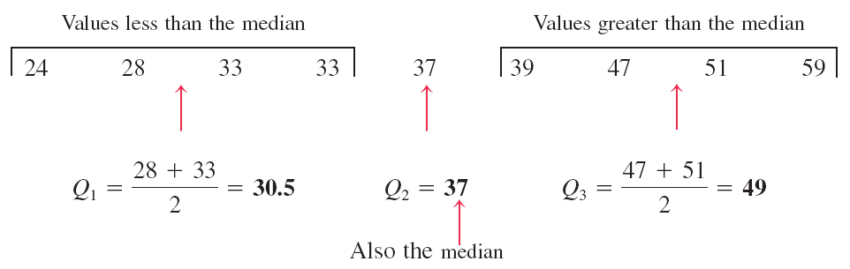
Example 3-24: Solution (1 of 2)
(a)
The age of 28 falls in the lowest 25% of the ages.

Slide 135
Example 3-24: Solution (2 of 2)
The interquartile range is
IQR = Interquartile range = Q₃ – Q₁ = 49 – 30.5
= 18.5 years

Slide 136
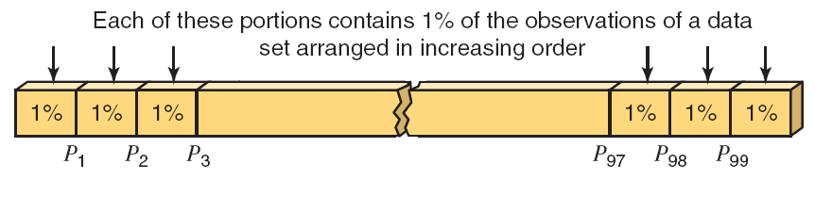
Percentiles and Percentile Rank (1 of 3)

Slide 137
Percentiles and Percentile Rank (2 of 3)
Calculating Percentiles
The (approximate) value of the k th percentile, denoted by P_{k}, is
where k denotes the number of the percentile and n represents the sample size.

Slide 138
Example 3-25
Refer to the data on one-way commuting times (in minutes) from home to college of 12 students given in Example 3–23, which is reproduced below.
29 | 14 | 39 | 17 | 7 | 47 | 63 | 37 | 42 | 18 | 24 | 55
Find the value of the 70th percentile. Give a brief interpretation of the 70th percentile.

Slide 139
Example 3-25: Solution (1 of 3)
We perform the following three steps to find the 70th percentile for the given data.
Step 1. First we rank the given data in increasing order as follows:
7 | 14 | 17 | 18 | 24 | 29 | 37 | 39 | 42 | 47 | 55 | 63

Slide 140
Example 3-25: Solution (2 of 3)
Step 2. We find the (k × n / 100) ^{th} term. Here n = 12 and k = 70, as we are to find the 70th percentile.
Thus, the 70th percentile, P₇₀, is given by the value of the 9th term in the ranked data set. Note that we rounded 8.4 up to 9, which is always the case when calculating a percentile.

Slide 141
Example 3-25: Solution (3 of 3)
Step 3. We find the value of the 9th term in the ranked data. This gives the value of the 70th percentile, P₇₀.
P₇₀ = Value of the 9th term = 42 minutes
Thus, we can state that approximately 70% of these 12 students commute for less than or equal to 42 minutes.

Slide 142
Percentiles and Percentile Rank (3 of 3)
Finding Percentile Rank of a Value

Slide 143
Example 3-26
Refer to the data on one-way commuting times (in minutes) from home to college of 12 students given in Example 3–23, which is reproduced below.
29 | 14 | 39 | 17 | 7 | 47 | 63 | 37 | 42 | 18 | 24 | 55
Find the percentile rank of 42 minutes. Give a brief interpretation of this percentile rank.

Slide 144
Example 3-26: Solution (1 of 3)
We perform the following three steps to find the percentile rank of 42.
Step 1. First we rank the given data in increasing order as follows:
7 | 14 | 17 | 18 | 24 | 29 | 37 | 39 | 42 | 47 | 55 | 63

Slide 145
Example 3-26: Solution (2 of 3)
Step 2. Find how many data values are less than 42.
In the above ranked data, there are eight data values that are less than 42.

Slide 146
Example 3-26: Solution (3 of 3)
Step 3. Find the percentile rank of 42 as follows given that 8 of the 12 values in the given data set are smaller than 42:
Rounding this answer to the nearest integral value, we can state that about 67% of the students in this sample commute for less than 42 minutes.

Slide 147
3.6 Box-and-Whisker Plot
Definition
A plot that shows the center, spread, and skewness of a data set. It is constructed by drawing a box and two whiskers that use the median, the first quartile, the third quartile, and the smallest and the largest values in the data set between the lower and the upper inner fences.

Slide 148
Example 3-27
The following data are the incomes (in thousands of dollars) for a sample of 12 households.
75 | 69 | 84 | 112 | 74 | 104 | 81 | 90 | 94 | 144 | 79 | 98
Construct a box-and-whisker plot for these data.

Slide 149
Example 3-27: Solution (1 of 5)
Step 1. First, rank the data in increasing order and calculate the values of the median, the first quartile, the third quartile, and the interquartile range. The ranked data are
69 | 74 | 75 | 79 | 81 | 84 | 90 | 94 | 98 | 104 | 112 | 144
Median = (84 + 90) / 2 = 87
Q₁ = (75 + 79) / 2 = 77
Q₃ = (98 + 104) / 2 = 101
IQR = Q₃ – Q₁ = 101 – 77 = 24

Slide 150
Example 3-27: Solution (2 of 5)
Step 2. Find the points that are 1.5 × IQR below Q₁ and 1.5 × IQR above Q₃.
1.5 × IQR = 1.5 × 24 = 36
Lower inner fence = Q₁ – 36 = 77 – 36 = 41
Upper inner fence = Q₃ + 36 = 101 + 36 = 137

Slide 151
Example 3-27: Solution (3 of 5)
Step 3. Determine the smallest and the largest values in the given data set within the two inner fences.
Smallest value within the two inner fences = 69
Largest value within the two inner fences = 112

Slide 152
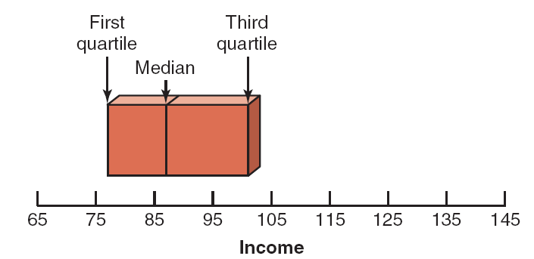
Example 3-27: Solution (4 of 5)
Step 4. Draw a horizontal line and mark the income levels on it such that all the values in the given data set are covered. The result of this step is shown in Figure 3.13.

Slide 153
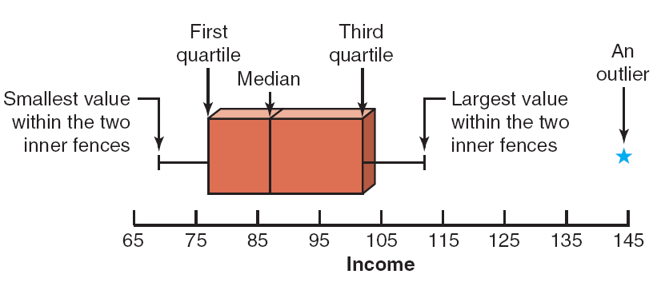
Example 3-27: Solution (5 of 5)
Step 5. By drawing two lines, join the points of the smallest and the largest values within the two inner fences to the box. These values are 69 and 112 in this example. This completes the box-and-whisker plot, as shown in Figure 3.14.

Slide 154
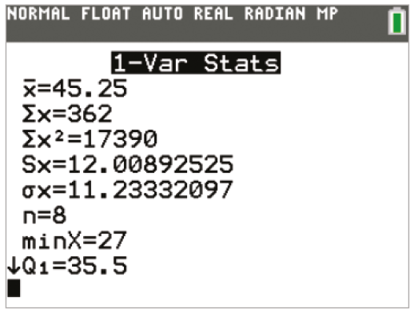
TI-84 Color/TI-84 (1 of 4)

Slide 155
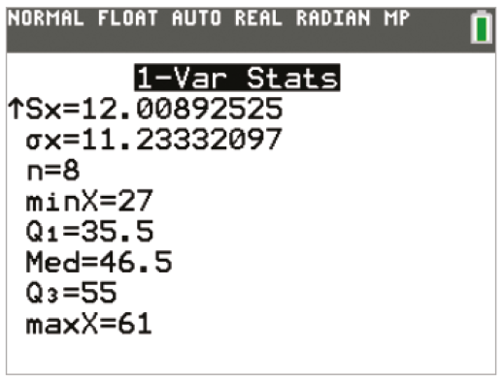
TI-84 Color/TI-84 (2 of 4)

Slide 156
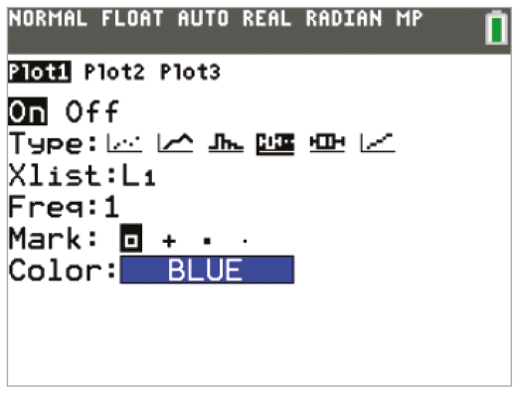
TI-84 Color/TI-84 (3 of 4)

Slide 157
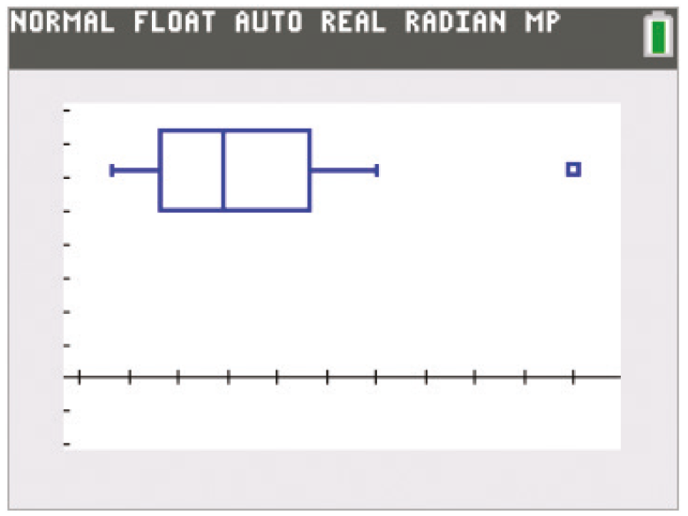
TI-84 Color/TI-84 (4 of 4)

Slide 158
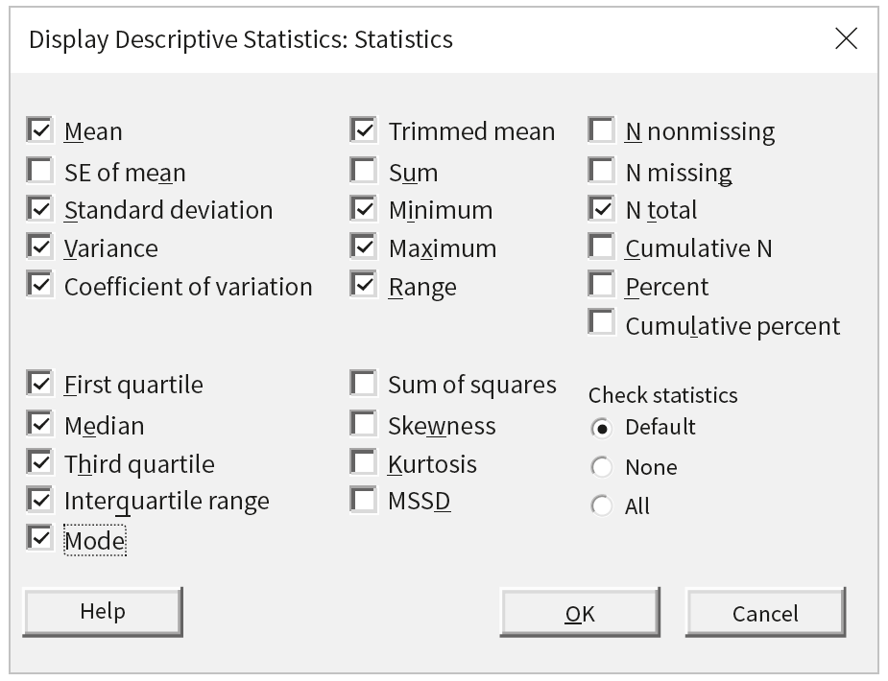
Minitab (1 of 3)

Slide 159
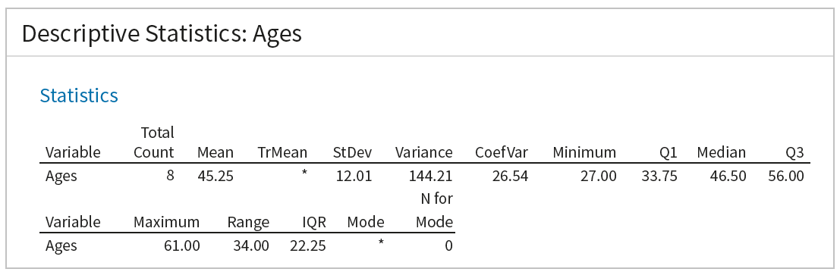
Minitab (2 of 3)

Slide 160
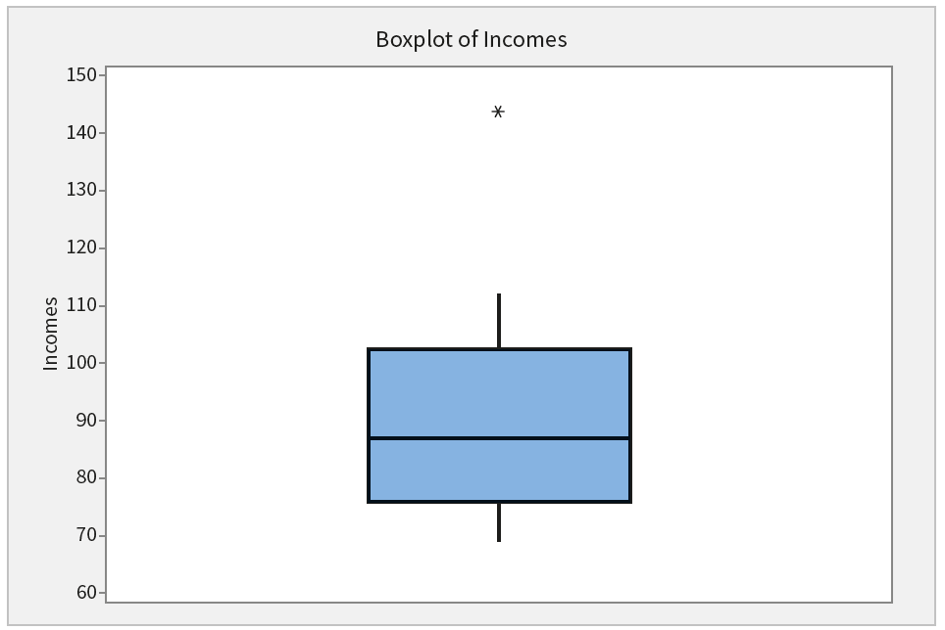
Minitab (3 of 3)

Slide 161
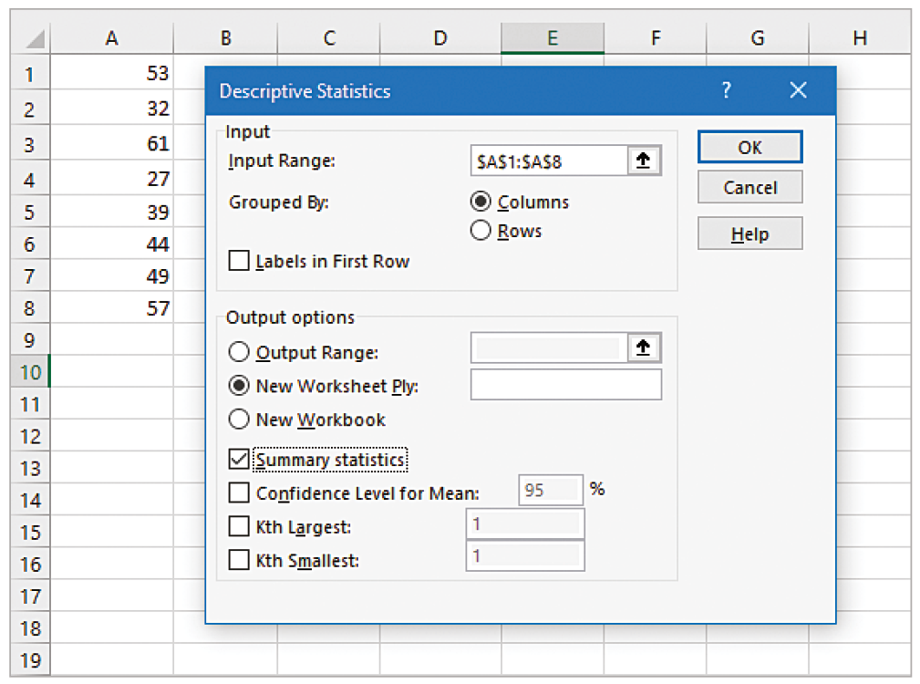
Excel (1 of 2)

Slide 162
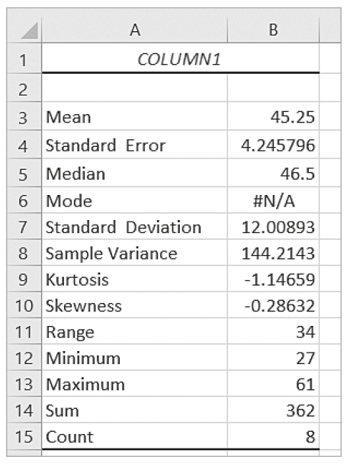
Excel (2 of 2)

Slide 163
Copyright
Copyright © 2021 John Wiley & Sons, Inc.
All rights reserved. Reproduction or translation of this work beyond that permitted in Section 117 of the 1976 United States Act without the express written permission of the copyright owner is unlawful. Request for further information should be addressed to the Permissions Department, John Wiley & Sons, Inc. The purchaser may make back-up copies for his/her own use only and not for distribution or resale. The Publisher assumes no responsibility for errors, omissions, or damages, caused by the use of these programs or from the use of the information contained herein.

